Slide 1



ThrivePath
Overcoming FTT Through Innovation.
Capstone Project Phase 1
Students:
Kfir Sharoni
Avishay Halifa
Supervisor:
Dr. Natali Levi-Soskin
Project Code:
25-1-D-17
1

Slide 2


INTRODUCTION
Failure to Thrive (FTT) is a pediatric health issue affecting growth and development, requiring multifaceted care. Current solutions often lack integration, creating challenges for families and professionals.
We propose a website that analyzes diagnostic data to provide personalized recommendations like meal plans and supplements, bridging gaps between diagnosis and care.
Parents, caregivers, and professionals gain actionable insights, while children with FTT receive timely, tailored support for improved outcomes.
2

Slide 3


EFFECTS AND PREVALENCE OF FTT
Impact on Children
FTT slows growth, weakens immunity, and delays learning, with emotional struggles like withdrawal and attachment issues.
Impact on Families
Families face stress, guilt, and financial strain, requiring support to manage challenges and improve outcomes
Prevalence
FTT affects 5–10% of children in primary care and 3–5% in hospitals in the U.S.
Most cases are identified before 18 months, a critical growth period
3
*Failure to Thrive: An Update, Cole, S. Z., & Lanham, J. S. (2011)

Slide 4

TREATING FAILURE TO THRIVE
Challenges in Treatment
FTT treatment requires coordinated medical, nutritional, and psychological interventions. Conflicts between disciplines emphasize the need for collaboration and comprehensive care planning.
Key Treatment Approaches
Medical: Targeted medications for underlying conditions like infections or metabolic disorders.
Nutritional: Energy-dense diets, supplements, and, in severe cases, tube feeding.
Psychological: Counseling for families, behavioral therapies, and caregiver support.
Support Systems & Digital Gaps
Resources include home nursing visits, nutritional counseling, and support groups, but digital tools focus on diagnosis, lacking integrated solutions for holistic FTT management.
4

Slide 5






OUR SOLUTION
ThrivePath Platform
A centralized website to address Failure to Thrive (FTT) in children by bridging diagnosis and customized intervention.
Nutrition & Hydration
Physical Activity
5
Tracking Progress
Sleeping Schedule

Slide 6


ENGINEERING PROCESS
Understanding FTT
Conducted in-depth research on FTT's causes, impacts, and existing care gaps, highlighting the need for early, integrated solutions
Identifying Gaps
Reviewed current tools and found they lack personalized, comprehensive care, leading to the development of a unified platform.
Platform Focus
Designed a solution emphasizing simplicity, accessibility, and personalized recommendations to empower families and caregivers.
6

Slide 7

INTERVIEW
An interview we conducted with Dr. Natalie Levy Soskin as part of understanding the needs of a parent of a child with FTT.
What types of treatments were offered to you?
A nutritionist and antacid medication.
Were there any dietary changes following the diagnosis? If so, what were they?
I tried to create a high-calorie, high-protein meal plan for him.
AI INTEGRATION
Does the child engage in physical activity? If so, what types of sports is he willing to do?
Fitness training. He does not want to do activities that are too difficult.
What functions or features would you expect to find in a digital system that assists with FTT treatment?
Tracking percentile changes, recommendations to encourage appetite.
If you could receive personalized recommendations from a digital system, what information would you want?
The child's percentiles and nutritional recommendations.
7

Slide 8
OUR MODEL
We use an Object-Process Methodology (OPM) diagram to showcase our model.
Inside the diagram, we:
Analyze the child’s profile and diagnostic data.
Calculate nutritional needs and supplementation requirements.
Generate a personalized treatment plan, including diet and lifestyle changes.
8

Slide 9
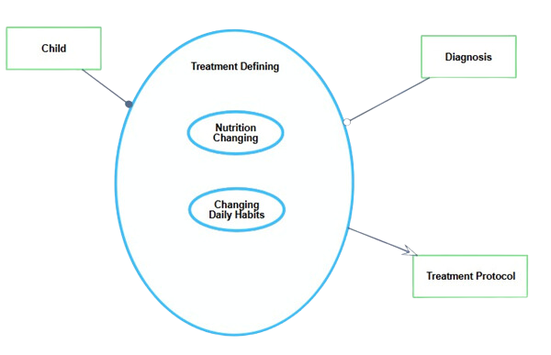
TREATMENT DEFINING
Input Sources
Child's profile: Includes age, gender, weight.
Diagnosis: Details the specific FTT condition.
Core Sub-Processes
Nutrition Changing: Adjusts the diet to meet nutritional needs.
Changing Daily Habits: Focuses on lifestyle improvements.
Tailored Growth Support
Combines all information from the previous steps into a comprehensive plan.
Provides actionable recommendations for nutrition and lifestyle to support the child's development.
9

Slide 10
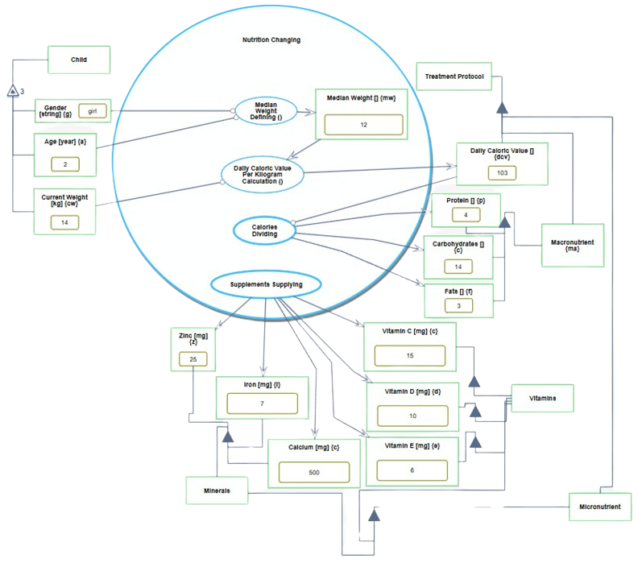
NUTRITION CHANGING
Purpose
Tailors dietary recommendations based on the child's profile (gender, age, weight).
Key Steps
Median Weight Defining: Determines target weight for healthy growth.
Caloric Value Calculation: Calculates daily caloric needs.
Calorie Distribution: Balances macronutrients (protein, carbohydrates, fats).
Supplement Supplying: Determines required vitamins and minerals.
Outcome
Integrates all calculations into a personalized treatment protocol for optimized growth and nutrition.
10

Slide 11
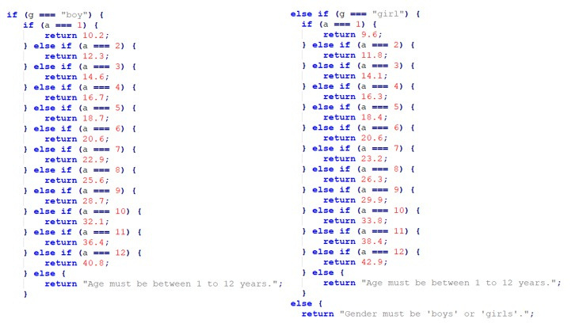
NUTRITION CHANGING
Purpose
Tailors dietary recommendations based on the child's profile (gender, age, weight).
Key Steps
Median Weight Defining: Determines target weight for healthy growth.
Caloric Value Calculation: Calculates daily caloric needs.
Calorie Distribution: Balances macronutrients (protein, carbohydrates, fats).
Supplement Supplying: Determines required vitamins and minerals.
Outcome
Integrates all calculations into a personalized treatment protocol for optimized growth and nutrition.
11

Slide 12
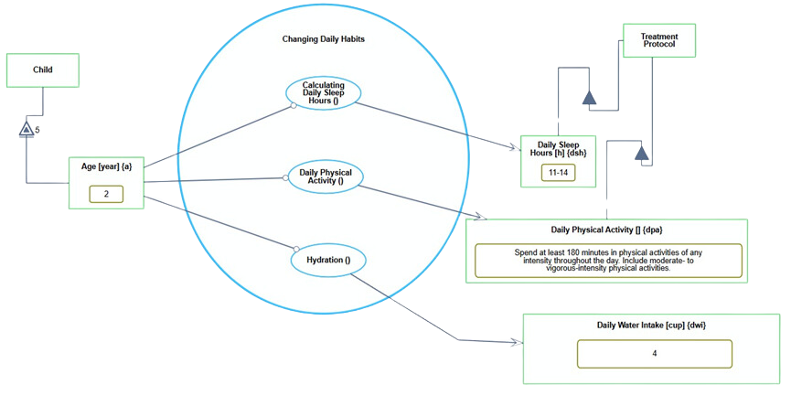
CHANGING DAILY HABITS
Purpose
Adjusts daily routines to improve overall health and development.
Key Steps
Sleep Calculation: Ensures sufficient rest based on age.
Physical Activity Planning: Promotes regular and active movement.
Hydration Goals: Recommends proper daily water intake.
Outcome
Incorporates these habits into the treatment protocol for a holistic approach to the child's well-being.
12

Slide 13
UML DIAGRAMS
13

Slide 14

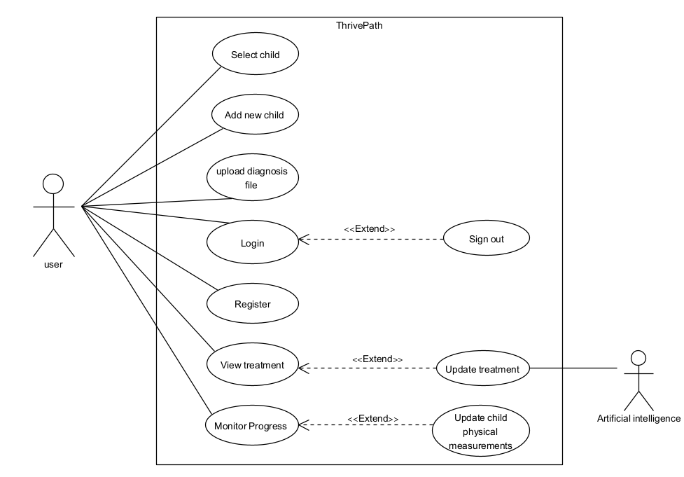
USE CASE DIAGRAM
VALUES
14

Slide 15
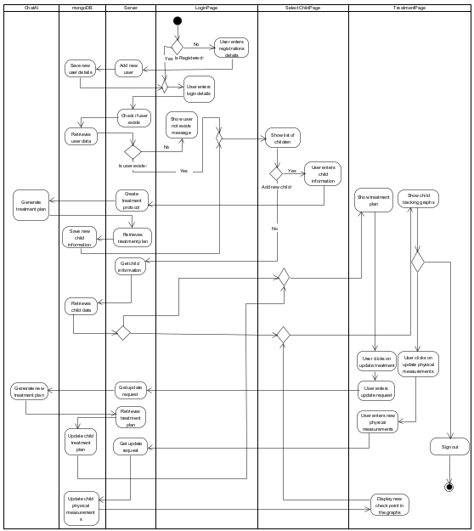
ACIVITY DIAGRAM
VALUES
15

Slide 16
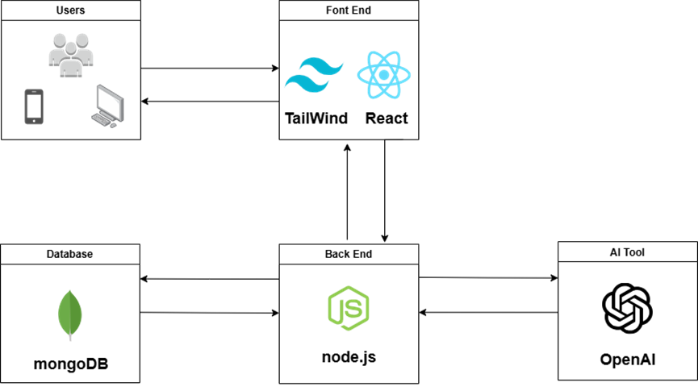
ARCHITECTURE DIAGRAM
System Architecture Overview
VALUES
16

Slide 17
FUNCTIONAL REQUIREMENTS
The system will allow users to log in.
The system will allow users to view a list of children they have added.
The system will allow users to add a new child.
The system will allow users to upload diagnostic files for a child.
The system will generate personalized treatment plans for each child.
The system will display growth charts for weight and height.
The system will allow users to update physical measurements for their children.
17

Slide 18
NON-FUNCTIONAL REQUIREMENTS
The system interface shall be intuitive and user-friendly, allowing easy navigation for all users.
The platform shall be responsive and adapt to various screen sizes, ensuring usability on desktop, tablet, and mobile devices.
The system shall load pages within 2 seconds under normal network conditions.
File uploads (up to 10MB) shall be processed within 5 seconds.
Recommendation generation shall be completed within 3 seconds.
The system shall automatically log out inactive users after 15 minutes for security purposes.
The system shall ensure that all stored data remains accurate, complete, and reliable across all operations.
The platform shall support Windows, macOS, iOS, and Android, ensuring consistent functionality across different operating systems
18

Slide 19
PROTOTYPE
19

Slide 20
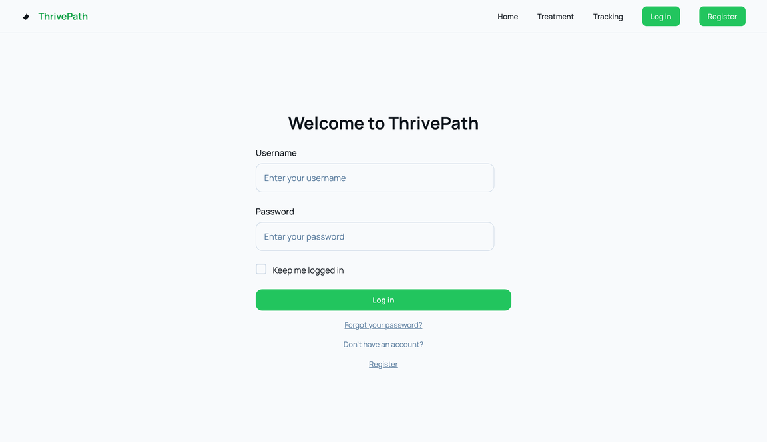
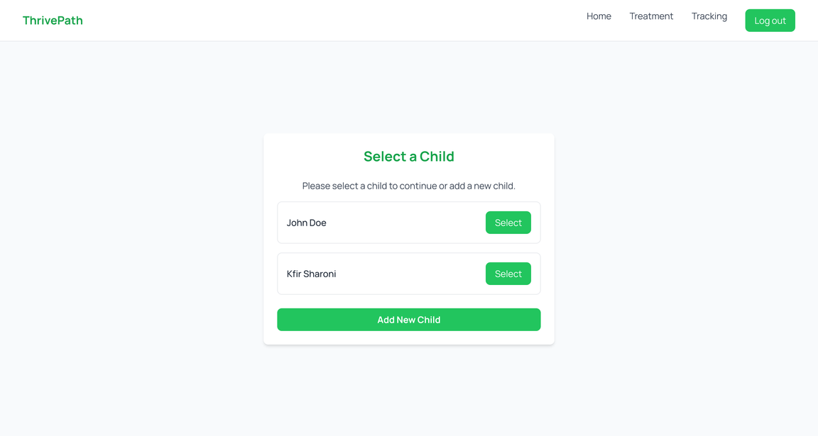
LOGIN & CHILD SELECTION
20

Slide 21
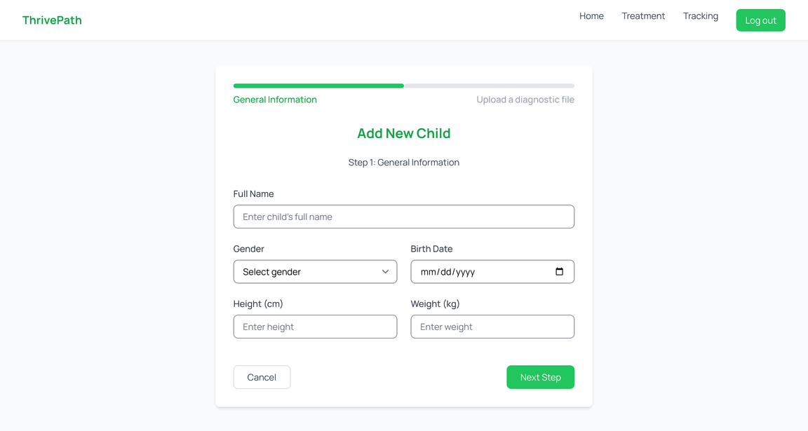
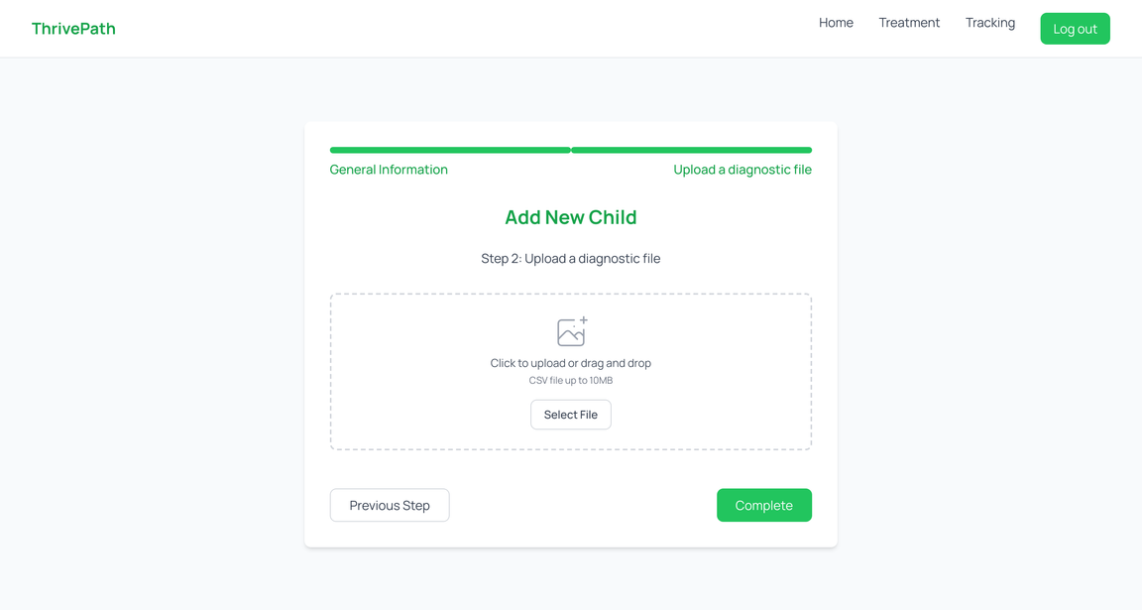
ADD NEW CHILD
21

Slide 22
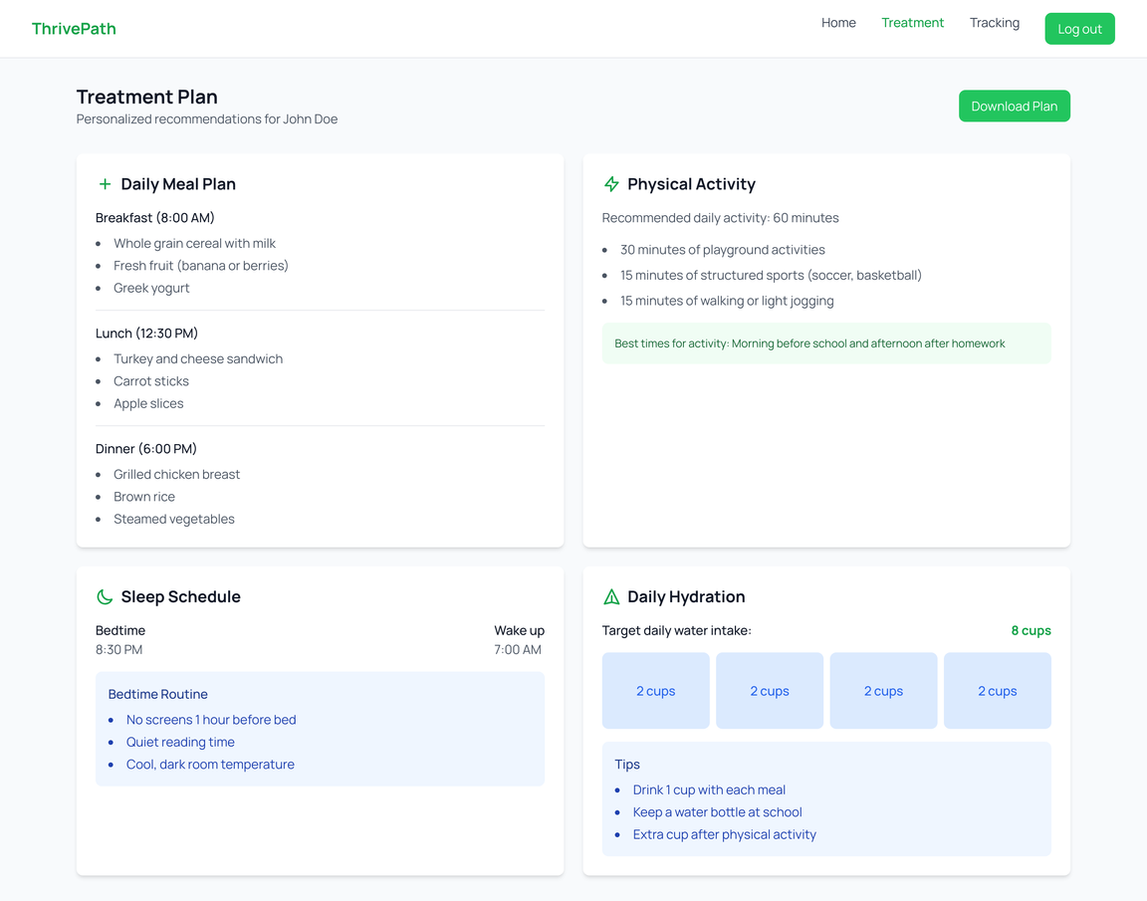
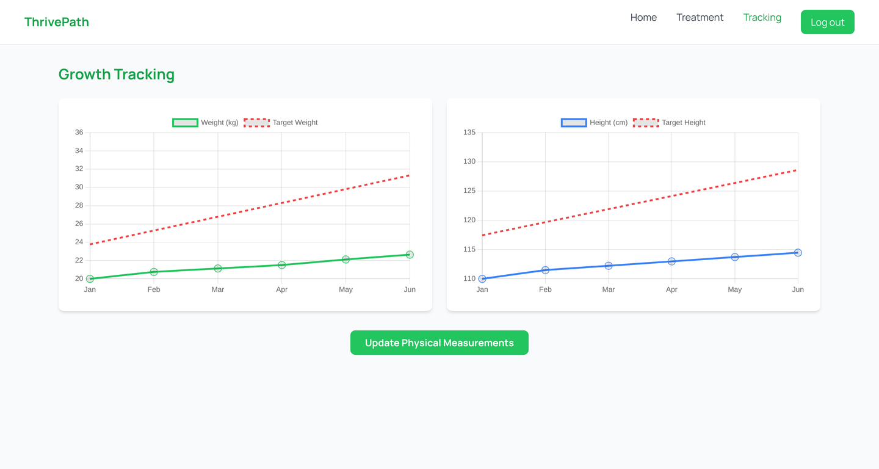
TREATMENT PLAN & TRACKING
22

Slide 23
VERIFICATION PLAN
Case | Test Case | Expected Result
1 | Login with invalid credentials | An error message should appear, informing the user of incorrect username or password.
2 | Register with missing or invalid inputs | An error message should appear, specifying the required fields or validation errors.
3 | Add a new child with valid details | The child should be added to the system, and the user should proceed to the next step to upload a diagnostic file.
4 | Upload a valid diagnostic file | The file should be uploaded successfully, and the user should be redirected to the child selection page or the next relevant screen.
5 | View the treatment plan for a child | The treatment plan should display the personalized recommendations, including meal plan, physical activity, sleep schedule, and hydration.
6 | Update physical measurements | The system should allow the user to input updated measurements, and the graphs should refresh to reflect the new data.
23

Slide 24

EXPECTED ACHIEVEMENTS
Goal:
Create a platform that addresses FTT with personalized recommendations and progress tracking.
Measuring Success
Accuracy: Test data inputs for children of varying ages and conditions, ensuring tailored and actionable outputs.
Usability: Collect feedback from users on different devices to improve navigation and accessibility.
Engagement: Monitor user activity, including the frequency of recommendations used and adjustments made.
24

Slide 25

EXPECTED CHALLENGES
DATA INTERPRETATION
Developing robust methods to accurately read and process diagnostic files.
Ensuring the system correctly extracts and utilizes relevant information.
AI INTEGRATION
Establishing seamless communication between the system and AI components.
Ensuring consistent, reliable outputs for generating personalized recommendations.
DATA SECURITY
Implementing advanced encryption techniques to safeguard sensitive medical data.
Adhering to regulatory standards like GDPR to maintain user trust and legal compliance.
USER TRUST
Demonstrating the system's accuracy and effectiveness through transparent results.
Providing a user-friendly interface and actionable insights to enhance credibility.
25

Slide 26
THANK YOU
26

